Slide 1
NODE Js
One Framework – Mobile & Desktop

Slide 2
Agenda
PRE-REQUISITES
Course Outline
Introduction

Slide 3
Pre-Requisites
Basic understanding of
HTML,
CSS,
JavaScript,
TypeScript, and
Document Object Model (DOM)

Slide 4
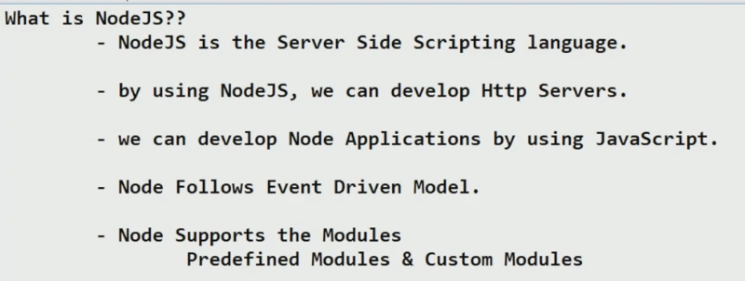
Node Js-Introduction

Slide 5
Modules in Node Js
Consider modules to be the same as JavaScript libraries.
A set of functions you want to include in your application.
Built-in Modules
Node.js has a set of built-in modules which you can use without any further installation.
include Modules
To include a module, use the require() function with the name of the module:
var http = require('http');

Slide 6
Modules in Node Js
http.createServer(function (req, res) { res.writeHead(200, {'Content-Type': 'text/html'}); res.end('Hello World!'); }).listen(8080);

Slide 7
Modules in Node Js
Create Your Own Modules
You can create your own modules, and easily include them in your applications.
The following example creates a module that returns a date and time object:
Example:
Use the exports keyword to make properties and methods available outside the module file.
Create a module that returns the current date and time:
exports.myDateTime = function () { return Date(); };

Slide 8
Modules in Node Js
var http = require('http');
var dt = require('./myfirstmodule');
http.createServer(function (req, res) {
res.writeHead(200, {'Content-Type': 'text/html'});
res.write("The date and time is currently: " + dt.myDateTime());
res.end();
}).listen(8080);

Slide 9
Modules in Node Js
var http = require('http');
var dt = require('./myfirstmodule');
http.createServer(function (req, res) {
res.writeHead(200, {'Content-Type': 'text/html'});
res.write("The date and time is currently: " + dt.myDateTime());
res.end();
}).listen(8080);

Slide 10
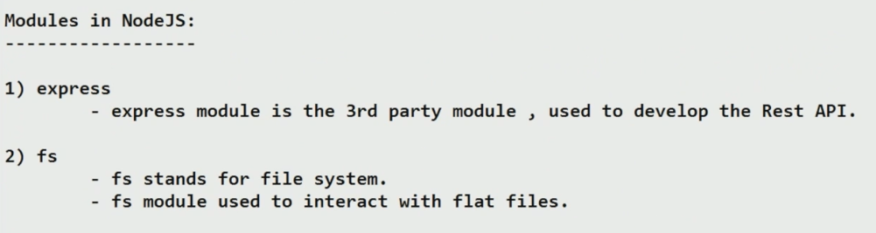
Modules in Node Js

Slide 11
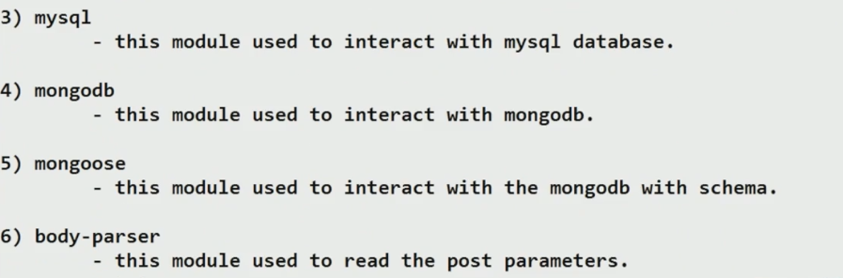
Node Js-Introduction

Slide 12
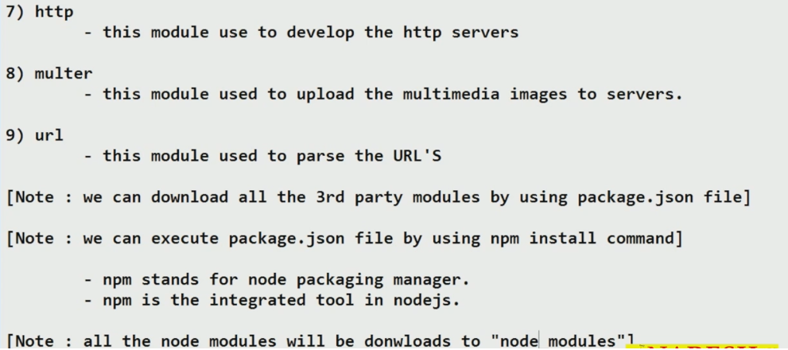
Node Js-Introduction

Slide 13
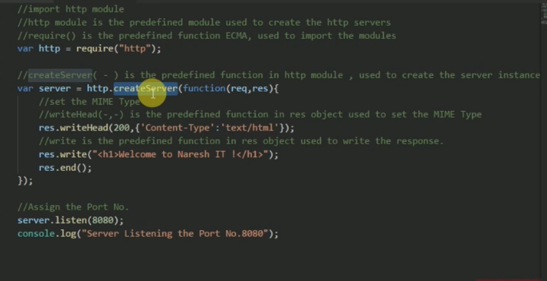
Create http server

Slide 14
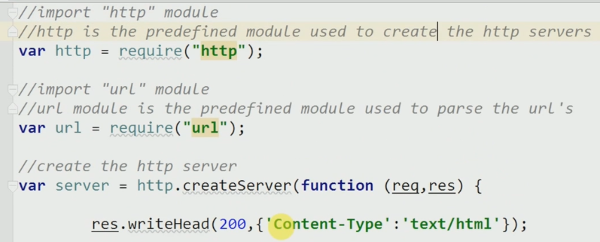
Read Get parameter

Slide 15
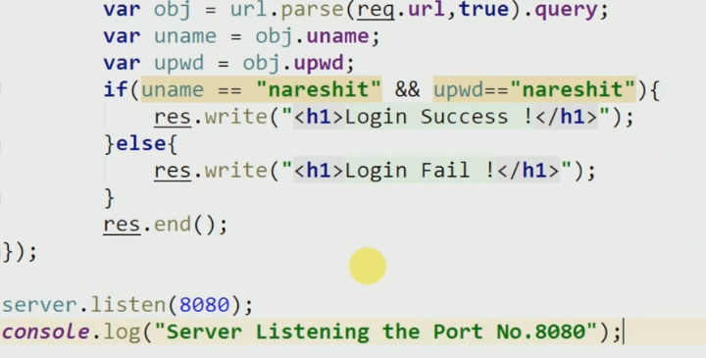
Read Get parameter

Slide 16
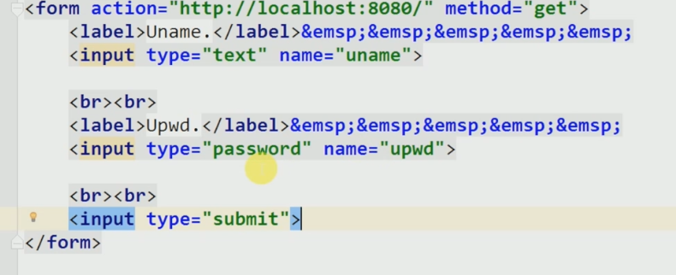
Read Get parameter

Slide 17
Node
for version check
Node –v
Nmp version
Npm –v

Slide 18
Node
C:\Users\Guest>node -v
v10.4.0
C:\Users\Guest>cd desktop
C:\Users\Guest\Desktop>mkdir nodejs
C:\Users\Guest\Desktop>cd nodejs
C:\Users\Guest\Desktop\nodejs>npm init
This utility will walk you through creating a package.json file.
It only covers the most common items, and tries to guess sensible defaults.
See `npm help json` for definitive documentation on these fields
and exactly what they do.
Use `npm install <pkg>` afterwards to install a package and
save it as a dependency in the package.json file.
Press ^C at any time to quit.
package name: (nodejs)

Slide 19
Environment Setup (Setup and Tooling)
Microsoft Windows [Version 6.1.7601]
Copyright (c) 2009 Microsoft Corporation. All rights reserved.
C:\Users\Guest>node -v
v10.4.0
C:\Users\Guest>cd desktop
C:\Users\Guest\Desktop>mkdir nodejs
C:\Users\Guest\Desktop>cd nodejs

Slide 20
Environment Setup (Setup and Tooling)
C:\Users\Guest\Desktop\nodejs>npm init
This utility will walk you through creating a package.json file.
It only covers the most common items, and tries to guess sensible defaults.
See `npm help json` for definitive documentation on these fields
and exactly what they do.
Use `npm install <pkg>` afterwards to install a package and
save it as a dependency in the package.json file.
Press ^C at any time to quit.
package name: (nodejs)

Slide 21
what are global objects in node and how to use them
Node.js global objects are global in nature and they are available in all modules. We do not need to include these objects in our application, rather we can use them directly. These objects are modules, functions, strings and object itself as explained below.
__dirname
__filename
exports
module
require()

Slide 22
Node js
Node.js is an open source server environment.
Node.js allows you to run JavaScript on the server.
Start learning Node.js now »
What is Node.js?
Node.js is an open source server environment
Node.js is free
Node.js runs on various platforms (Windows, Linux, Unix, Mac OS X, etc.)
Node.js uses JavaScript on the server

Slide 23
Why Node.js?
Node.js uses asynchronous programming!
A common task for a web server can be to open a file on the server and return the content to the client.
Here is how PHP or ASP handles a file request:
Sends the task to the computer's file system.
Waits while the file system opens and reads the file.
Returns the content to the client.
Ready to handle the next request.

Slide 24
What Can Node.js Do?
Node.js can generate dynamic page content
Node.js can create, open, read, write, delete, and close files on the server
Node.js can collect form data
Node.js can add, delete, modify data in your database
What is a Node.js File?
Node.js files contain tasks that will be executed on certain events
A typical event is someone trying to access a port on the server
Node.js files must be initiated on the server before having any effect
Node.js files have extension ".js"

Slide 25
Why Node.js?
Here is how Node.js handles a file request:
Sends the task to the computer's file system.
Ready to handle the next request.
When the file system has opened and read the file, the server returns the content to the client.
Node.js eliminates the waiting, and simply continues with the next request.
Node.js runs single-threaded, non-blocking, asynchronously programming, which is very memory efficient.

Slide 26
Why Node.js?
Here is how Node.js handles a file request:
Sends the task to the computer's file system.
Ready to handle the next request.
When the file system has opened and read the file, the server returns the content to the client.
Node.js eliminates the waiting, and simply continues with the next request.
Node.js runs single-threaded, non-blocking, asynchronously programming, which is very memory efficient.

Slide 27
Branches
Push all branches to your remote repository:
git push --all origin
$ git push -d <remote_name> <branch_name>
$ git branch -d <branch_name> Note that in most cases the remote name is origin.
Delete Local Branch
To delete the local branch use one of the following:
$ git branch -d branch_name
$ git branch -D branch_name

Slide 28
Branches
Update from the remote repository:
Fetch and merge changes on the remote server to your working directory:
git pull
To merge a different branch into your active branch:
git merge <branchname>
View all the merge conflicts:View the conflicts against the base file:
git diffgit diff --base <filename>
git diff <sourcebranch> <targetbranch> Preview changes, before merging:

Slide 29
Filtering the Commit History LOG
By Amount- The most basic filtering option for git log is to limit the number of commits that are displayed. When you’re only interested in the last few commits, this saves you the trouble of viewing all the commits in a page.
git log -3
By Date- If you’re looking for a commit from a specific time frame, you can use the --after or --before flags for filtering commits by date. These both accept a variety of date formats as a parameter.
git log --after="2014-7-1“
You can also pass in relative references like "1 week ago" and "yesterday":
git log --after="yesterday"

Slide 30
Filtering the Commit History LOG
By Amount- The most basic filtering option for git log is to limit the number of commits that are displayed. When you’re only interested in the last few commits, this saves you the trouble of viewing all the commits in a page.
git log -3
By Date- If you’re looking for a commit from a specific time frame, you can use the --after or --before flags for filtering commits by date. These both accept a variety of date formats as a parameter.
git log --after="2014-7-1“
You can also pass in relative references like "1 week ago" and "yesterday":
git log --after="yesterday"

Slide 31
Filtering the Commit History LOG
To search for a commits that were created between two dates, you can provide both a --before and --after date. For instance, to display all the commits added between July 1st, 2014 and July 4th, 2014, you would use the following:
git log --after="2014-7-1" --before="2014-7-4“
By Author
git log --author="John“
By Message
git log --grep="JRA-224:“
By File
git log – about.html

Slide 32
Filtering the Commit History LOG
To search for a commits that were created between two dates, you can provide both a --before and --after date. For instance, to display all the commits added between July 1st, 2014 and July 4th, 2014, you would use the following:
git log --after="2014-7-1" --before="2014-7-4“
By Author
git log --author="John“
By Message
git log --grep="JRA-224:“
By File
git log --about.html

Slide 33
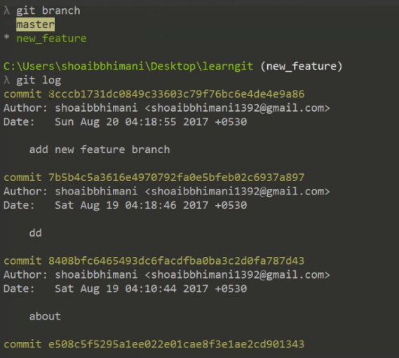
git cherry-pick- TRANFER ON COMMITE ONE BRANCH TO ANOTER

Slide 34
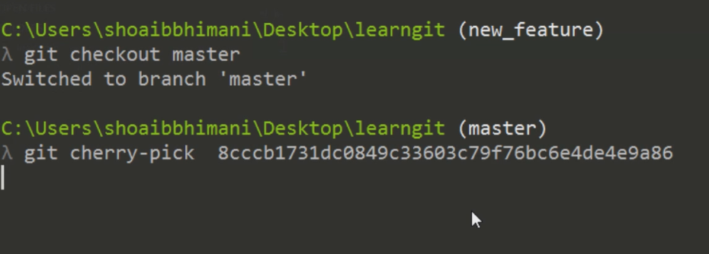
git cherry-pick

Slide 35
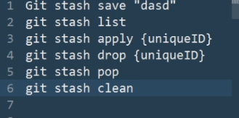
stash

Slide 36
Workshop Outline

Slide 37
Course Outline
Introduction to Angular
Angular Building Blocks
Angular Feature Overview
The Big Picture
Angular CLI
Angular Application Flow
Angular Docs
Angular JS to Angular

Slide 38
Course Outline
The Angular JumpStart Application
Application Overview
Application Structure
Components and Modules
Components Overview
Component Lifecycle
Create a new Component
Angular Modules

Slide 39
Course Outline:
Template Expressions and Pipes
Templates Syntax Overview
Interpolation and Expressions
Working with Pipes
Component Properties and Data Binding
Property and Event Binding
Input and Output Properties
Two-way Binding

Slide 40
Course Outline
• Component Model (Decorators, Templating Syntax, Data Binding, ) • Dependency Injection • Lazy-loading

Slide 41
Introduction

Slide 42
Introduction to Angular
Angular (commonly referred to as "Angular 5" or "Angular 2") is a TypeScript-based open-source front-end web application platform led by the Angular Team at Google and by a community of individuals and corporations. Angular is a complete rewrite from the same team that built AngularJS.

Slide 43
Introduction to Angular
There are three major releases of Angular. The first version that was released is Angular1, which is also called AngularJS. Angular1 was followed by Angular2, which came in with a lot of changes when compared to Angular1.
The structure of Angular is based on the components/services architecture. AngularJS was based on the model view controller. Angular 4 released in March 2017 proves to be a major breakthrough and is the latest release from the Angular team after Angular2.
Angular 4 is almost the same as Angular 2. It has a backward compatibility with Angular 2. Projects developed in Angular 2 will work without any issues with Angular 4.

Slide 44
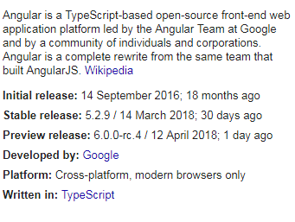
Introduction to Angular

Slide 45
Single-page application
A single-page application (SPA) is a web application or web site that interacts with the user by dynamically rewriting the current page rather than loading entire new pages from a server. This approach avoids interruption of the user experience between successive pages, making the application behave more like a desktop application. In an SPA,

Slide 46
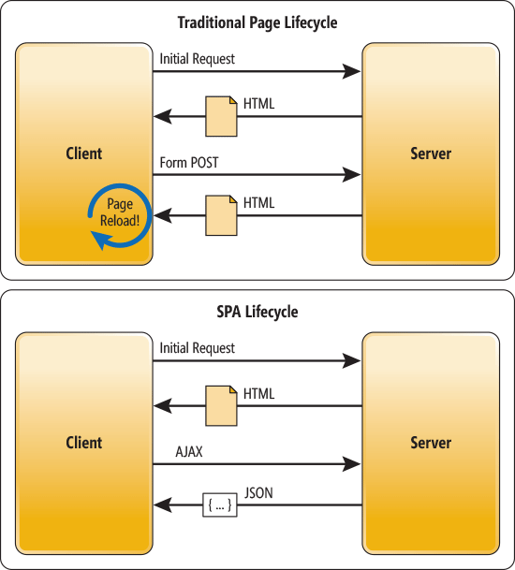
The Traditional Page Lifecycle vs. the SPA Lifecycle

Slide 47
The Traditional Page Lifecycle vs. the SPA Lifecycle
If you want to see a Single Page Application in action, I invite you to head over to the AngularUniv https://angular-university.io and start clicking on the home page on the list of latest courses, and on the top menu.
If you start navigating around, you will see that the page does not fully reload – only new data gets sent over the wire as the user navigates through the application – that is an example of a single page application.

Slide 48
Environment Setup(Setup and Tooling)
Prerequisites
Both the CLI and generated project have dependencies that require Node 6.9.0 or higher, together with NPM 3 or higher

Slide 49
Environment Setup(Setup and Tooling)
npm install -g @angular/cli
ng new PROJECT-NAME
cd PROJECT-NAME
ng serve
Navigate to http://localhost:4200/.

Slide 50
Angular cli
Angular cli is a command line interface to scaffold and build angular apps using nodejs style (commonJs) modules. Not only it provides you scalable project structure, instead it handles all common tedious tasks for you out of the box.
COMMAND LINE INTERFACE FOR ANGULAR APPS
npm install -g angcli

Slide 51
Components
Major part of the development with Angular is done in the components. Components are basically classes that interact with the .html file of the component, which gets displayed on the browser. We have seen the file structure in one of our previous chapters. The file structure has the app component and it consists of the following file

Slide 52
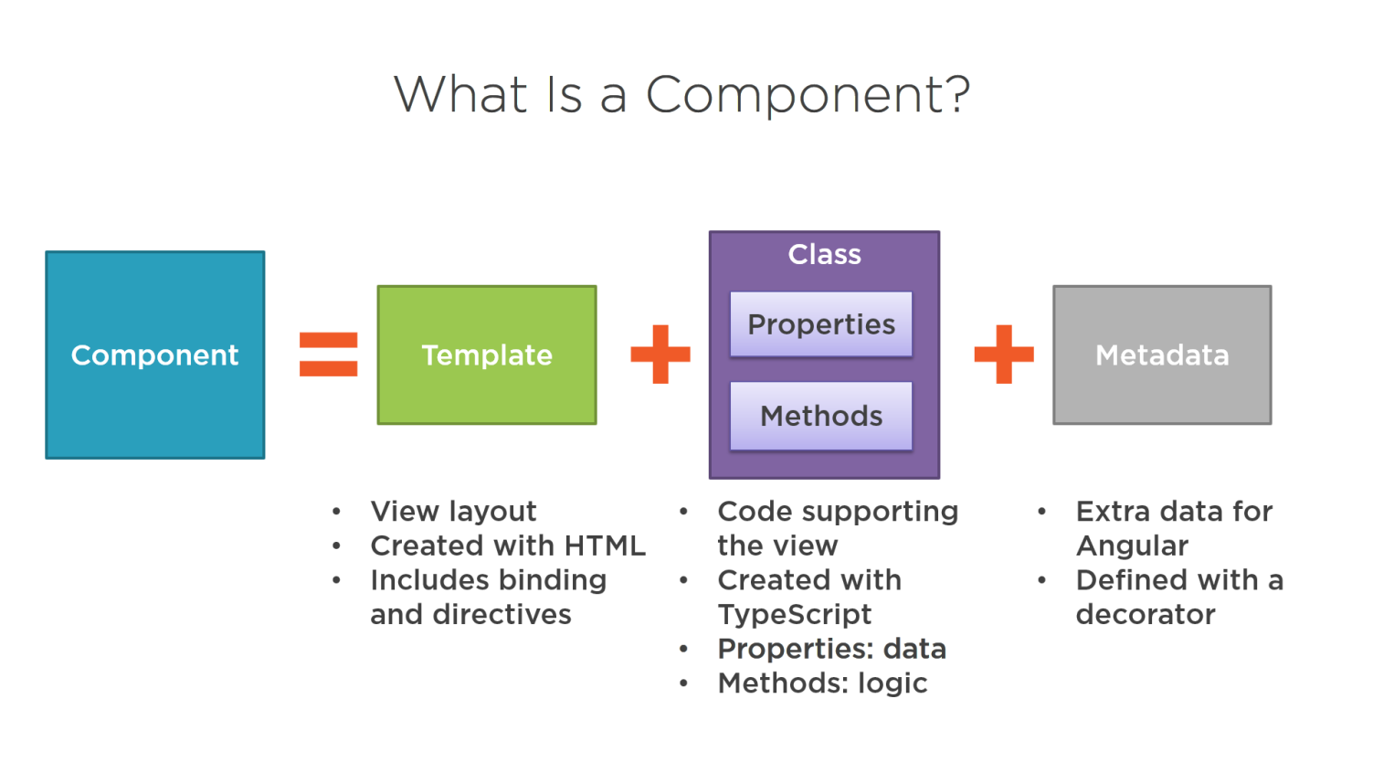
Components

Slide 53
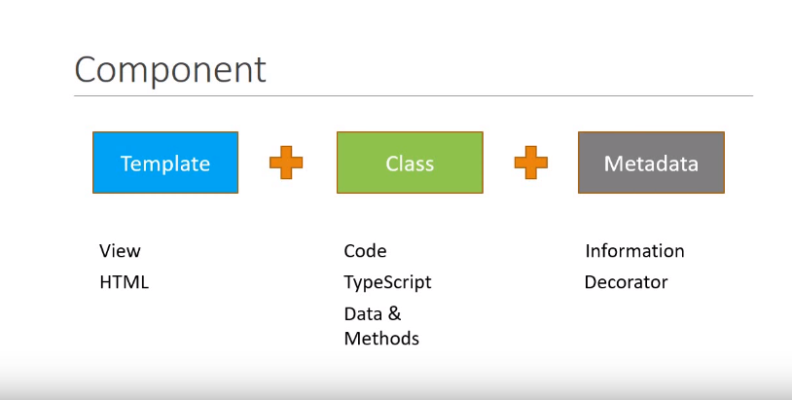
Component

Slide 54
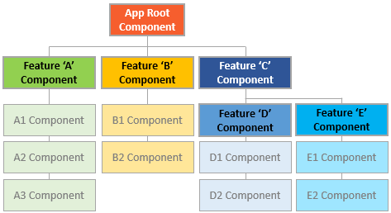
Components

Slide 55
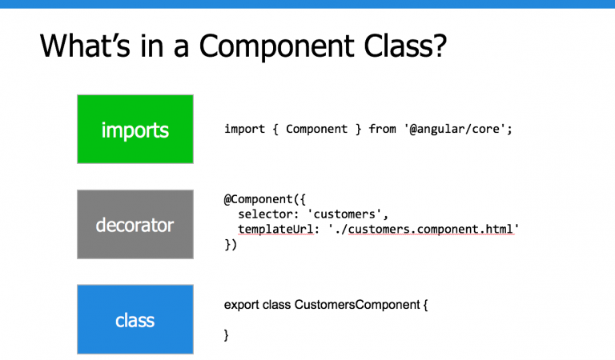
Components Class

Slide 56
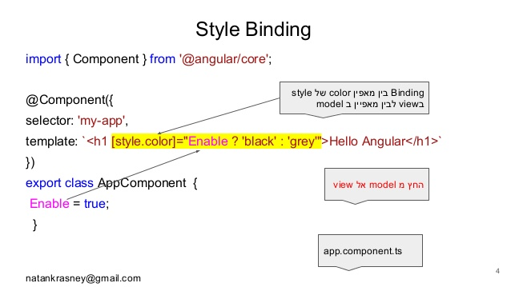
Components Style binding

Slide 57
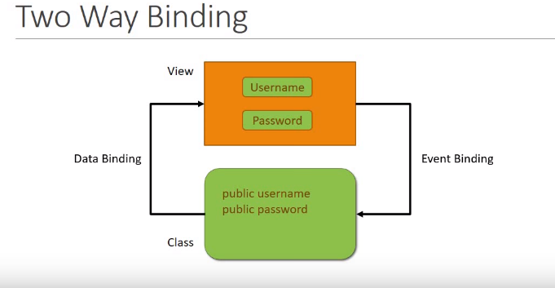
Two way Binding

Slide 58
Component Files
app.component.css
app.component.html
app.component.spec.ts
app.component.ts
app.module.ts

Slide 59
Module
Module in Angular refers to a place where you can group the components, directives, pipes, and services, which are related to the application.
In case you are developing a website, the header, footer, left, center and the right section become part of a module.
To define module, we can use the NgModule. When you create a new project using the Angular –cli command, the ngmodule is created in the app.module.ts file

Slide 60
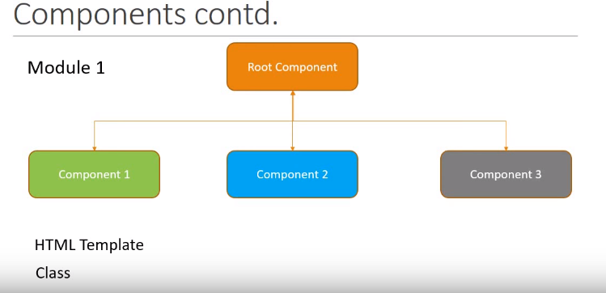
Module

Slide 61
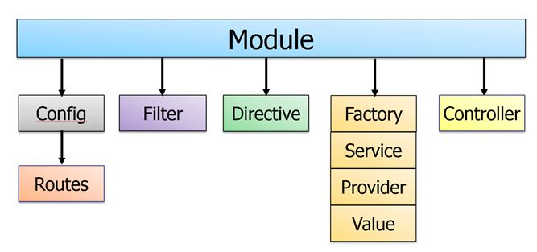
Module

Slide 62
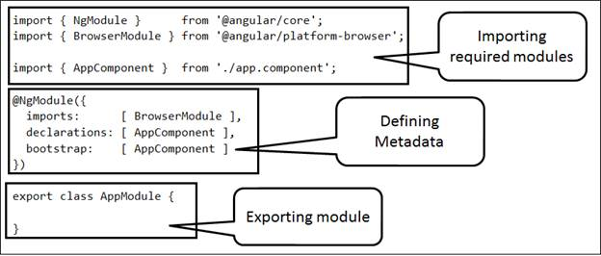
Module

Slide 63
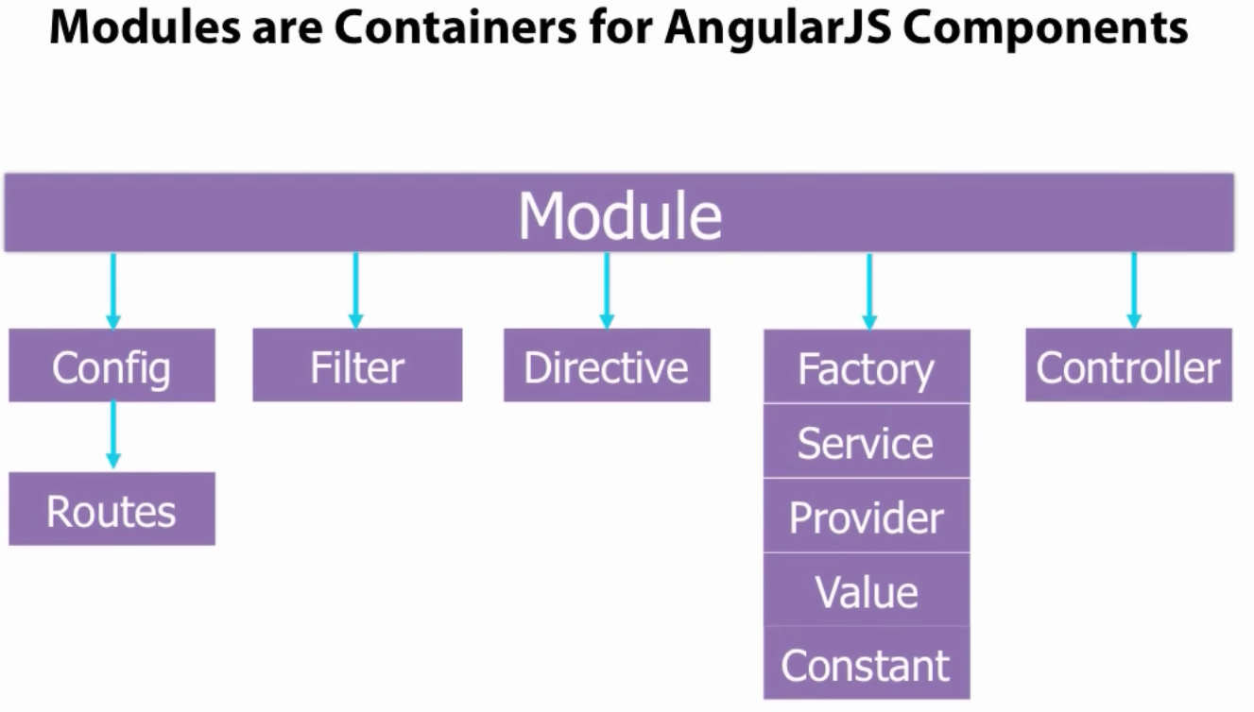
Module

Slide 64
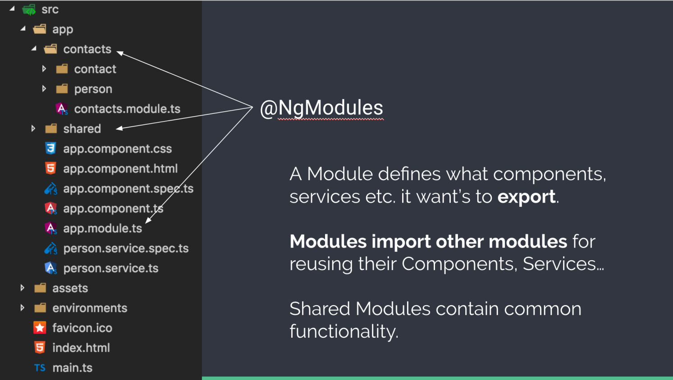
Module

Slide 65
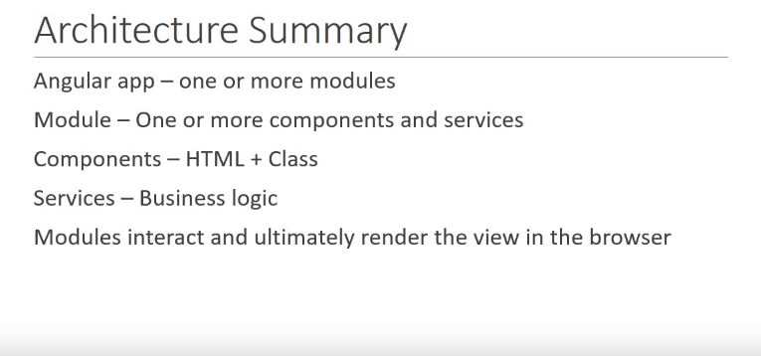
Module

Slide 66
Module

Slide 67
Npm Packages(How angular flow)
The Angular CLI, Angular applications, and Angular itself depend upon features and functionality provided by libraries that are available as npm packages.
package.json
https://angular.io/guide/npm-packages

Slide 68
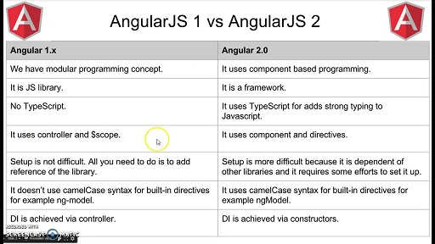
AngularJS1 vs Angular

Slide 69
Angular Folder Structure
https://angular.io/guide/quickstart#the-src-folder
Root Module and root Component with in app folder.
App.module.ts
App .component.ts

Slide 70
Angular Folder Structure
main.ts when we run ng serve command the executing start from main.ts

Slide 71
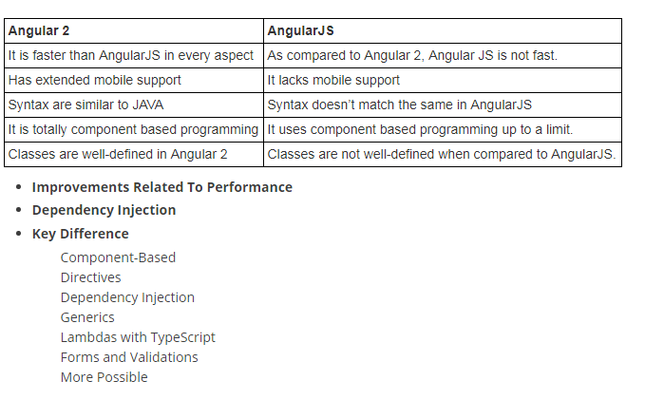
AngularJS1 vs Angular

Slide 72
Data Binding
Data Binding is available right from AngularJS, Angular 2 and is now available in Angular 4 as well. We use curly braces for data binding - {{}}; this process is called interpolation.
The variable in the app.component.html file is referred as {{title}} and the value of title is initialized in the app.component.ts file and in app.component.html, the value is displayed.

Slide 73
Templates
Angular 4 uses the <ng-template> as the tag instead of <template>which is used in Angular2. The reason Angular 4 changed <template> to <ng-template> is because there is a name conflict between the <template> tag and the html <template> standard tag. It will deprecate completely going ahead. This is one of the major changes in Angular 4.

Slide 74
Pipes
Pipes were earlier called filters in Angular1 and called pipes in Angular 2 and 4.
The | character is used to transform data. Following is the syntax for the same
{{ Welcome to Angular 4 | lowercase}}

Slide 75
Pipes
Angular 4 provides some built-in pipes. The pipes are listed below −
Lowercase pipe
Uppercase pipe
Date pipe
Currency pipe
Jsonpipe
Percent pipe
Decimal pipe
Slicepipe

Slide 76
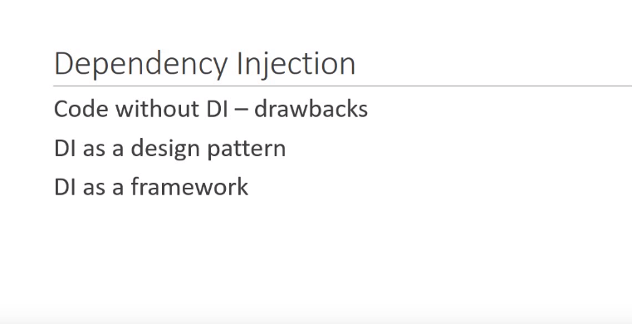
Dependency Injection

Slide 77
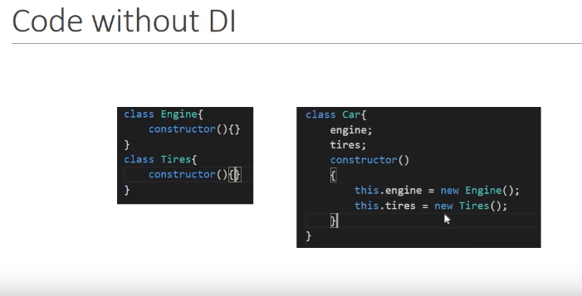
Dependency Injection

Slide 78
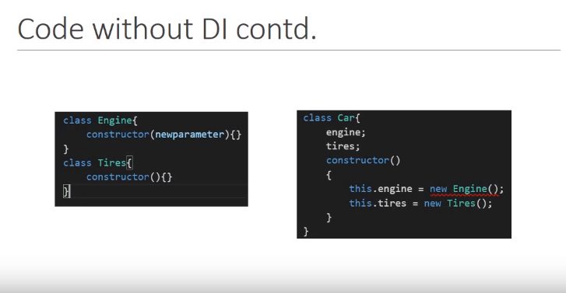
Dependency Injection

Slide 79
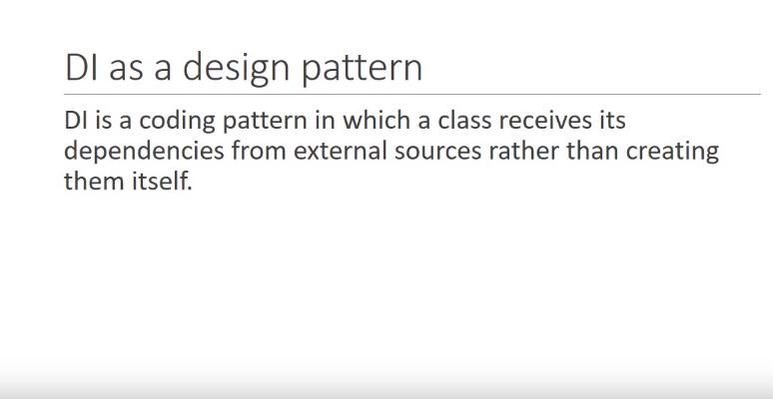
Dependency Injection

Slide 80
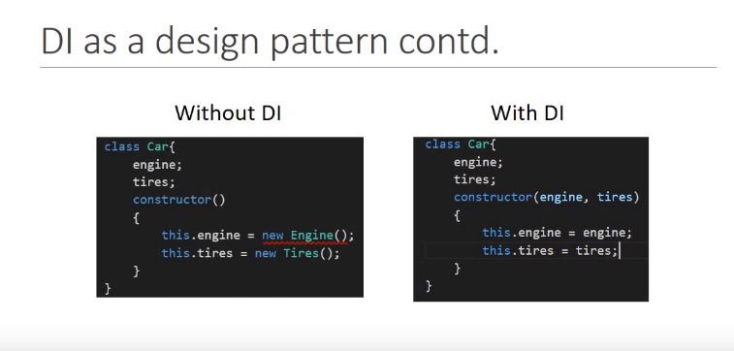
Dependency Injection

Slide 81
Open House
Any Questions / Queries / Inputs

Slide 82
Feedback & Reviews
Valuing Contribution

Slide 83
Thank You

